Slide 1
surface accustic waves

Slide 2
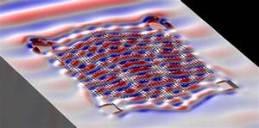
Special Issue on Surface Acoustic Waves in Semiconductor ...

Slide 3
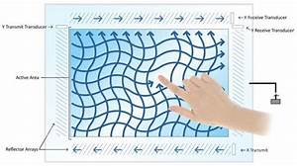
Colvin Curiosity

Slide 4
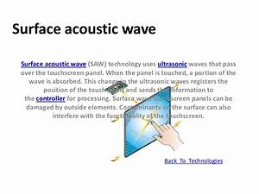
Surface acoustic wave

Slide 5
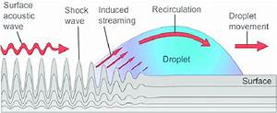
Surface acoustic wave (SAW) (according to Tan et al. 274 ...

Slide 6
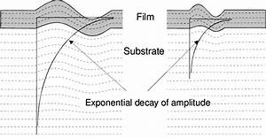
Download ...

Slide 7
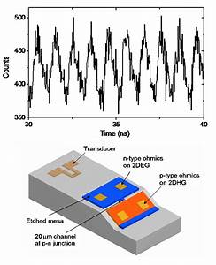
Surface Acoustic Waves — Department of Physics

Slide 8
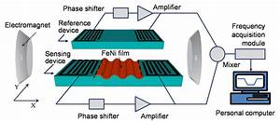
The scheme and working principle of the surface acoustic ...

